Slide 1
Line Follower
Python with Robots Mission 6
Lesson 1 Objectives 1-3

Slide 2

Pre-Mission Warm-Up
In your Mission 6 Lesson 1 log, answer the pre-mission warm-up questions:
How do you read a line sensor?
What surface colors have the highest readings?
What code assigns a Boolean value from a reading?

Slide 3

Mission 6: Line Follower
Follow the road!
Self-driving cars, autonomous flying drones and other computing systems that navigate on their own have some basic principles in common.

Slide 4
Mission 6: Line Follower
Whether you are writing code for a vehicle with a high-powered vision processing system or CodeBot’s low-power sensors, you’ll face many of the same challenges.
Based on sensor inputs, what actions should you take to stay on the path?

Slide 5
Mission 6: Line Follower
In this project you will build and refine a line following robot.
Line followers are a staple in robotics competitions, such as races or mazes.
But even basic line followers aren’t just for competitions!
Robots that zip through warehouses often follow lines as they pick up items you order when shopping online.

Slide 6
Mission 6: Line Follower
Project Goals:
Create a basic line follower using 2-edge sensors.
Improve the design with a center-line sensor to keep it straight.
Use all 5 sensors for proportional steering control.

Slide 7
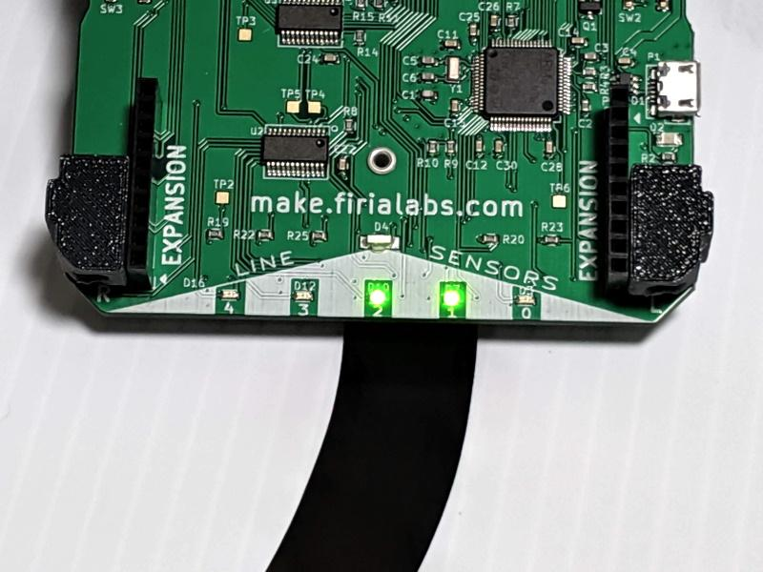
Mission 6: Line Follower
For this lesson, we will work on the first task:
Create a basic line follower using 2-edge sensors.

Slide 8
Objective #1: Speedy Sensing!
Your line follower ‘bot will need to continuously check for a line beneath all 5 sensors.
Your detect_line(n) function did that in the last project.
It read the line sensor.
It compared the reading to a threshold and returned a Boolean value for is_detected.

Slide 9
Objective #1: Speedy Sensing!
Here is the algorithm for this project:
Read all five sensors.
Compare the values to a threshold and store the Boolean values.
Decide how to steer based on all 5 Boolean values.
Repeat continuously in a loop.

Slide 10
Objective #1: Speedy Sensing!
In Fence Patrol, you didn’t need to store the Boolean values.
They were used to increment the counter and call a function.
But for this project, you will use all the values at the same time to make a driving decision.

Slide 11
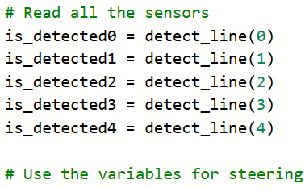
Objective #1: Speedy Sensing!
You could store each Boolean value in a variable like this:

Slide 12
Objective #1: Speedy Sensing!
But that code has a lot of repetition…not very DRY!
Also, reading the line sensors takes time and can slow down the control.
It sure would be nice if there was a better way to deal with a list of Boolean values.
Something like … a list!

Slide 13
Objective #1: Speedy Sensing!
Concept: list
A list is a sequence of items you can access with an index.
Each item in the list has a specific position, starting with 0.
The position is called the index.
You define a list using square brackets [ ]
The len() function returns the length, or number of items, of a list.

Slide 14
Objective #1: Speedy Sensing!
Concept: list
Example:
my_list = [5, 3, 6, 9, 1, 7]
len(my_list) = 6
Index | 0 | 1 | 2 | 3 | 4 | 5
Item | 5 | 3 | 6 | 9 | 1 | 7
my_list =

Slide 15
Objective #1: Speedy Sensing!
Concept: list
Access a single item in the list using [ ]
my_list = [5, 3, 6, 9, 1, 7]
first_item = my_list[0] # The value is 5
third_item = my_list[2] # The value is 6
Index | 0 | 1 | 2 | 3 | 4 | 5
Item | 5 | 3 | 6 | 9 | 1 | 7
my_list =

Slide 16
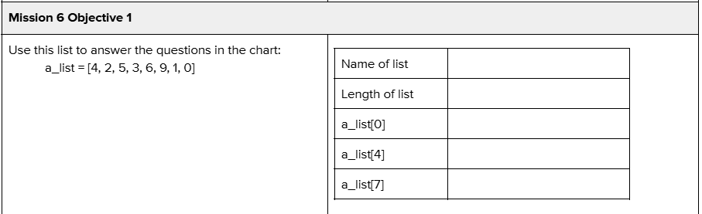
Objective #1 Activity
DO THIS:
Practice working with lists using the problems in your mission log.

Slide 17
Objective #1: Speedy Sensing!
Make a fast function
With a list, you can make a function that checks the line sensors and returns is_detected for all of them.

Slide 18
Objective #1: Speedy Sensing!
detect_line(n) and scan_lines()
Open your LineSense program from the last project.
Review the functions detect_line(n) and scan_lines().
This program will combine the first line of detect_line() with most of the code in scan_lines() to define and update Boolean values in a list.

Slide 19
Objective #1 Activity
DO THIS:
Start a new file – CheckLines.
Define a new function check_lines(thresh) that:
  Reads the line sensors.
  Compares each to a given threshold.
  Stores all the Boolean values in a list.
  Returns the list to the function call.

Slide 20
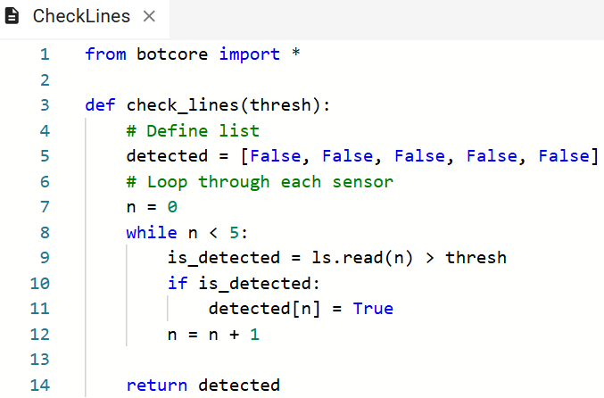
Objective #1 Activity

Slide 21

Objective #1 Activity
DO THIS:
Test the function by calling it in the main program.

Slide 22
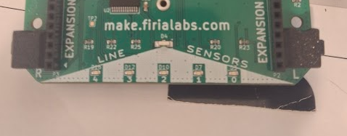
Objective #1 Activity
DO THIS:
Put the ‘bot on the white rectangle from the Testing Surfaces paper.
Place a black piece of paper under a couple of line sensors.

Slide 23
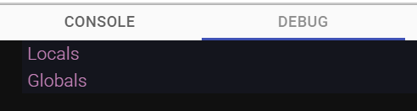
Objective #1 Activity
DO THIS:
Click on Debug.
Open the Console Panel
Open the “Debug” window.
Click on “Step In” a few times.

Slide 24
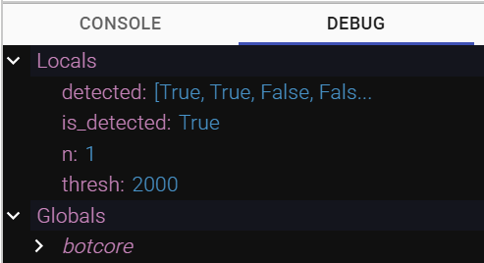
Objective #1 Activity
DO THIS:
Click on the dropdown arrow next to Locals.
Observe the values of the variables as you step through the code.

Slide 25
Objective #2: Using the REPL
Your program doesn’t do much right now.
The program ends quickly, since it only calls check_lines(2000) one time.
But wait, there’s more to the story.
You can still interact with CodeBot’s Python environment using the REPL, which is part of the Console Panel.

Slide 26
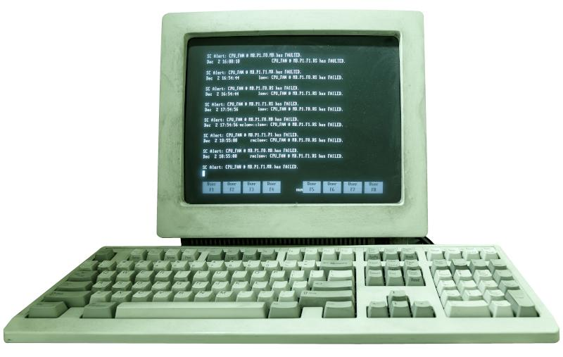
Objective #2: Using the REPL
Concept: REPL
You can type in Python statements directly to the console panel.
This is called REPL.
“Read Evaluate Print Loop”
It is a command line for typing in code directly.
This lets you test code instructions one line at a time.

Slide 27
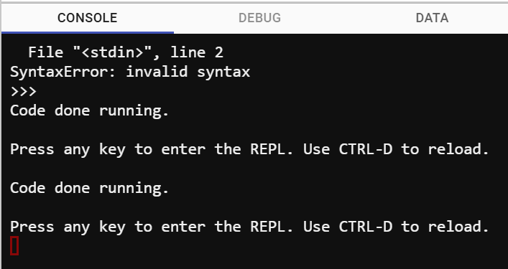
Objective #2 Activity
DO THIS:
Open the Console Panel
Make sure the “console” window is active.
You may see a message like this. If so, press <enter>.

Slide 28
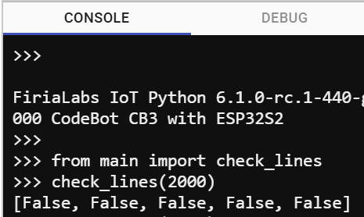
Objective #2 Activity
DO THIS:
Make sure you are at the bottom of the window.
Type in this code:

Slide 29
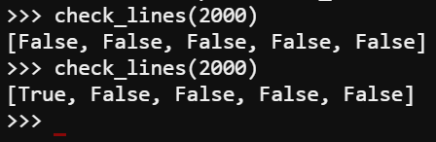
Objective #2 Activity
DO THIS:
Put the small black paper under a line sensor.
Type check_lines(2000) again and see what the values are.
Do this a few more times.

Slide 30

Mission quiz
Now …. time for a quiz!
Answer the four quiz questions in CodeSpace.
CODEX
QUIZ

Slide 31
Objective #3: Magic Lights Redux
You are going to want the line sensor LEDs to turn on/off when running the line follower program.
Another feature of botcore is:
You can pass a list of bools directly to leds.ls()

Slide 32
Objective #3: Magic Lights Redux
leds.ls([False, True, True, False, False])
Index/
LED
0 1 2 3 4

Slide 33
Objective #3: Magic Lights Redux
In Mission 3, you learned how to use
binary numbers to turn on LEDs.
All of these commands do the same thing:
leds.ls(6)
leds.ls(0b00110)
leds.ls([False, True, True, False, False])
Index
LED
0 1 2 3 4

Slide 34
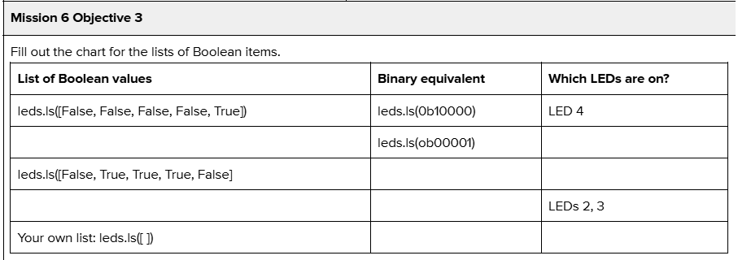
Objective #3 Activity
DO THIS:
Practice coding a list of Boolean items to turn on/off the line sensor LEDs using the problems in your mission log.

Slide 35
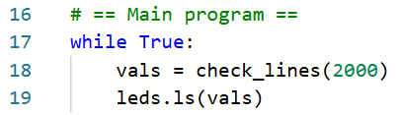
Objective #3 Activity
DO THIS:
Add code to the main program that turns on/off the line sensor LEDs using the list of Booleans

Slide 36
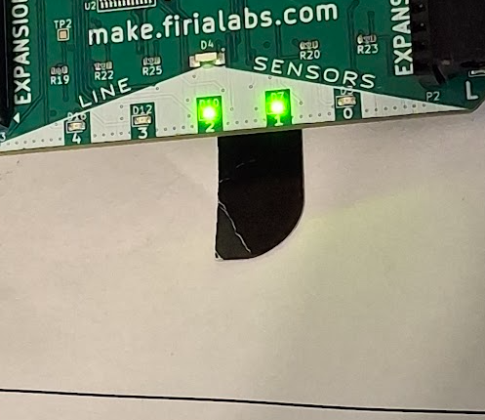
Objective #3 Activity
DO THIS:
Run the program and test the ‘bot
on a white surface.
Move the small black paper under different line sensors and watch the LEDs turn on/off.

Slide 37

Extensions
Here are two additional elements you can add to your program:
Add code for pressing BTN-1 to stop the program (break).
Add a sound when a line is detected, and a different sound (or no speaker) when no line is detected.

Slide 38
Post-Mission Reflection
Complete the post-mission reflection in your Mission 6 Lesson 1 Log:
What is a list?
What is an index?
How can a list be used in a program?

